Slide 1
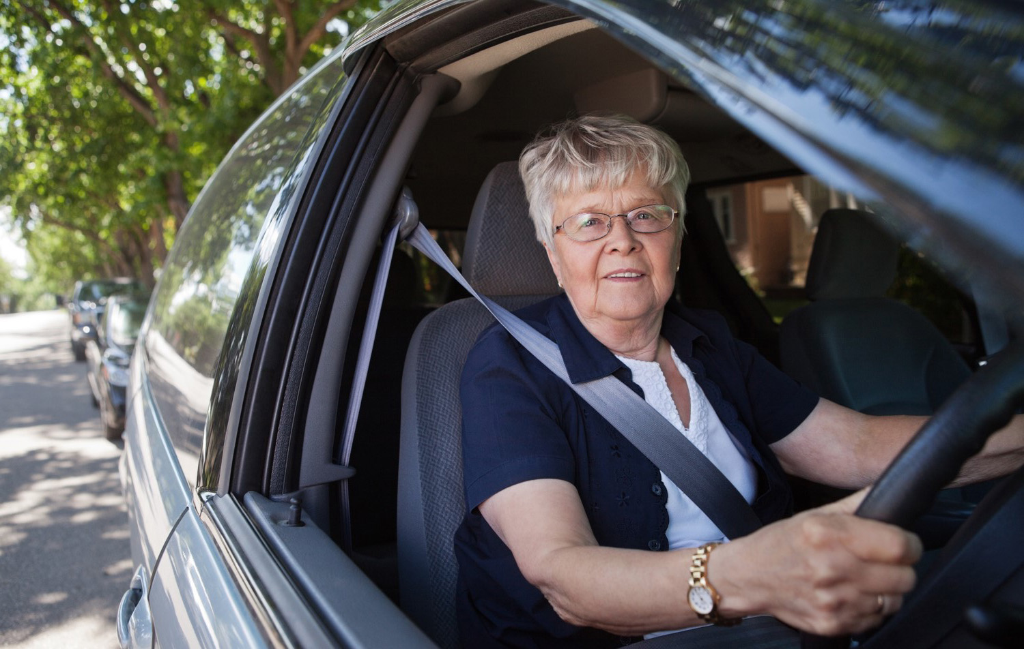
Is your driving changing?
Top tips to help you drive safely for longer

Slide 2

As we get older, changes in our fitness and eyesight can affect our ability to drive safely…
Text Here

Slide 3
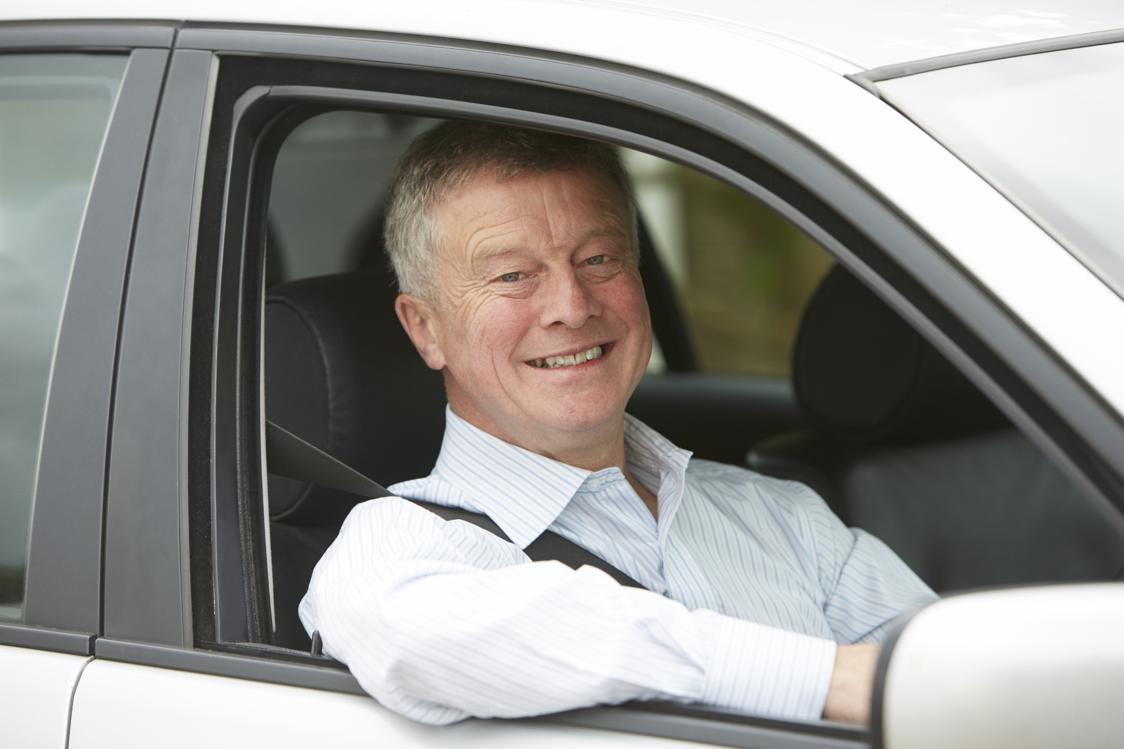
But, there are lots of things we can do to continue driving safely for as long as possible…

Slide 4
1
Make sure you’re fit to drive

Slide 5
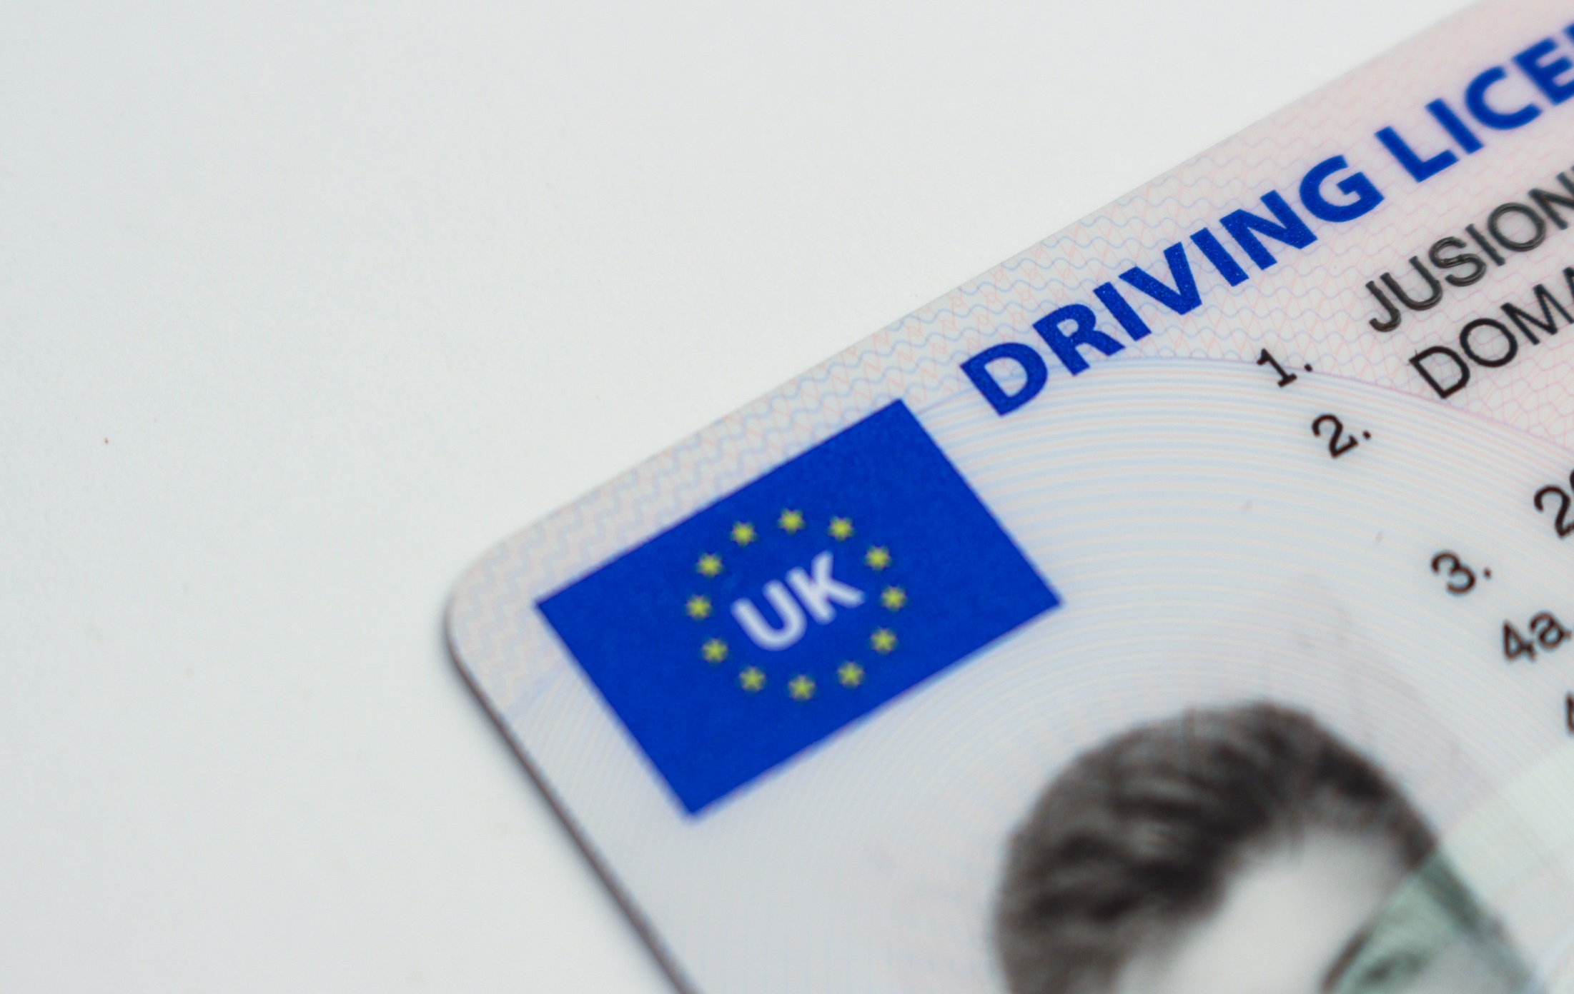
Common conditions to be aware of include:
changes in eyesight
diabetes
epilepsy
heart disease
stroke
Parkinson’s disease
dementia
arthritis
hearing problems
sleep disorders
If you are worried that your driving might be changing, discuss this with friends, family or your GP.
Some health changes need to be reported to the DVLA. If you are not sure, ask your GP or the DVLA for advice.

Slide 6
1
2
Make sure you’re fit to drive
Take regular driving assessments

Slide 7
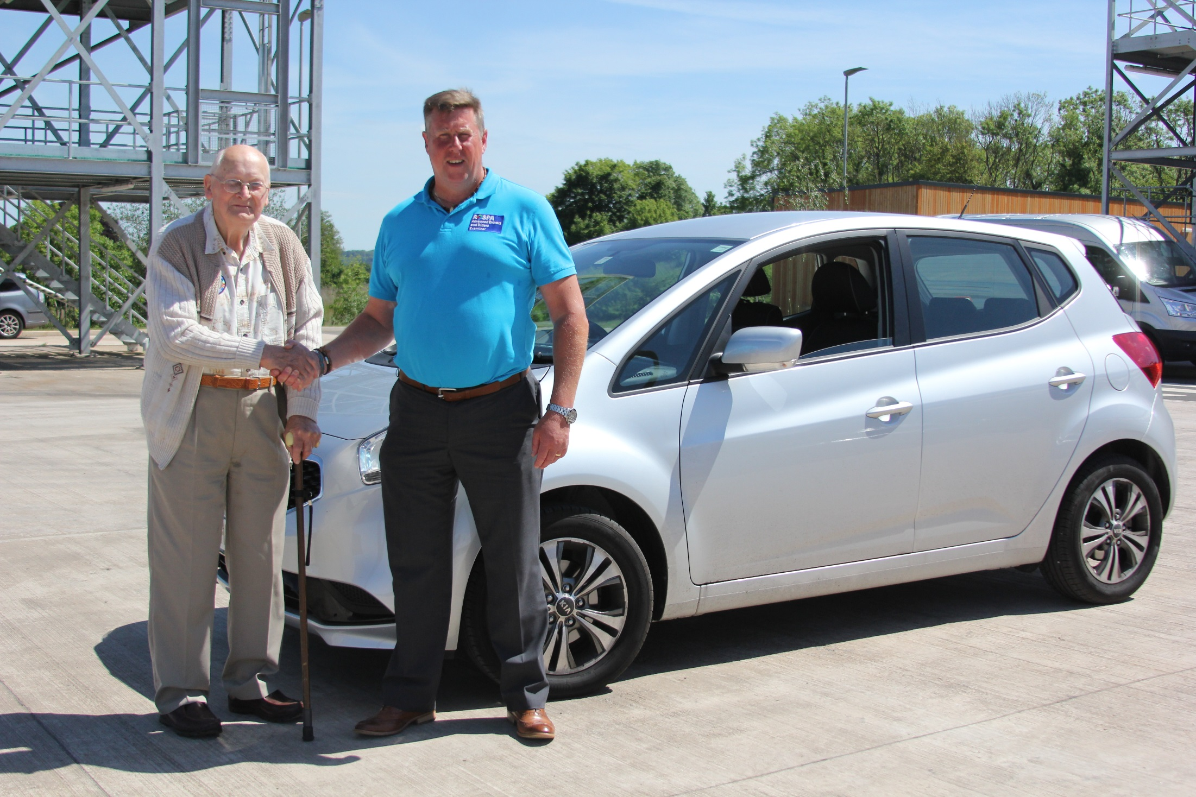
A driving assessment can help you to identify how your driving is changing and what you can do to continue driving safely.
This is NOT a test, but a friendly check of your driving strengths and weaknesses. It is also confidential.
If you have a medical condition or disability, take an assessment at a Mobility Centre.
To find out more about driver assessments, visit: http://www.olderdrivers.org.uk/driver-assessment/

Slide 8
1
2
Make sure you’re fit to drive
Take regular driving assessments
3
Change when and where you drive

Slide 9

Some drivers choose to avoid situations they find difficult, such as the rush hour or at night.
You might also choose to reduce the amount of driving you do.

Slide 10
1
2
Make sure you’re fit to drive
Take regular driving assessments
3
4
Change when and where you drive
Change or adapt your vehicle

Slide 11

A wide range of accessories, such as steering aids and hand controls can help you adapt your vehicle to your needs.

Slide 12

If the time comes when you need to retire from driving, take advice from friends, family and healthcare professionals.
There are lots of alternatives, such as public transport, taxis and lifts from family and friends, which could be cheaper than running a car.
Retiring from driving

Slide 13

For more information:
Visit: www.olderdrivers.org.uk
Email: info@olderdrivers.org.uk
Call: 0808 801 0822
Text Here

